Slide 1
Smart Contracts
Daniele Marazzina

Slide 2

Ethereum
It is another platform developed on blockchain technology
In order to be able to run on the peer-to-peer network, Ethereum users pay for the use through a cryptocurrency, called Ether, which therefore acts both as a cryptocurrency and as a fuel.
Ethereum is different from the Bitcoin blockchain since it is constructed to create Smart Contracts. Even in Bitcoin, elementary smart contracts can be created. In Ethereum the peculiarity is that they are listed on a complete Turing language.
A smart contract is a program that runs on Ethereum's decentralized virtual machine.
The smart contract cannot act actively (for example, it cannot monitor the status of another smart contract and act accordingly), but it acts reactively (a user, not necessarily directly, must invoke it to perform any operation).
The smart contract cannot interrogate the world outside the blockchain. For example, in the case of a sports bet managed through a smart contract, this cannot obtain the result of the game from a website and act accordingly.
The smart contract can instead obtain information using oracles.
Oracles are smart contracts in which information from the outside world is loaded in exchange for a reward.

Slide 3
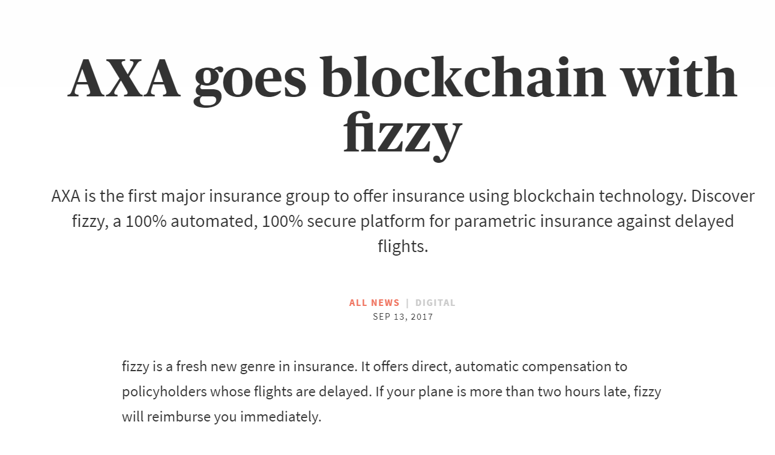

Slide 4
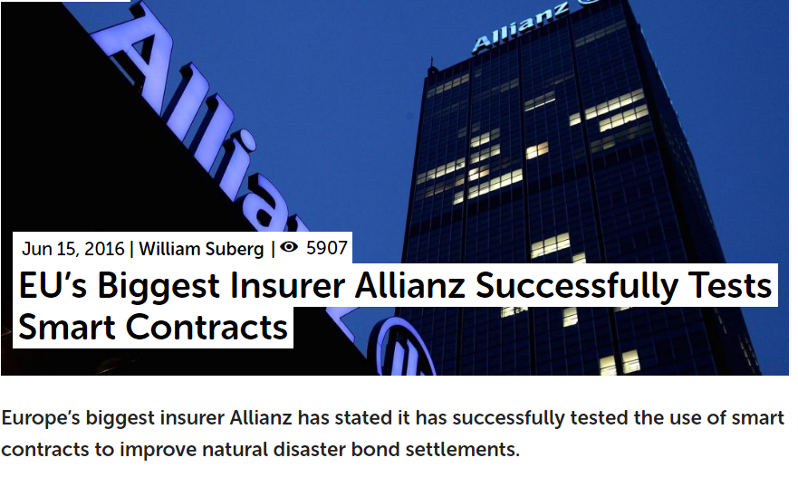

Slide 5
Where to use smart contracts???
Finance: posting of a collateral, to solve the counterparty risk problem
What is a collateral?
Put simply, collateral is an item of value that a lender can seize from a borrower if he or she fails to repay a loan according to the agreed terms. One common example is when you take out a mortgage. Normally, the bank will ask you to provide your home as collateral.
Collateral acts as a guarantee that the lender will receive back the amount lent even if the borrower does not repay the loan as agreed.
What is counterparty risk?
Counterparty risk is the likelihood or probability that one of those involved in a transaction might default on its contractual obligation.

Slide 6
Collateral and Counterparty risk: mark to market
If A enter into a contract with B, then both can suffer counterparty risk! Therefore collateral can help to reduce that risk.
>> Now: payment of collateral is done at settlement dates, through a third party
“consensus by reconciliation”
>> Smart Contract: continuous and automatic payment, through mark to market evaluation
“decentralized consensus”

Slide 7
Where to use smart contract???
Insurance: flights… and other case of insurance contract where an oracle can act
Example: I want to create a tourism insurance contract against rain
Bob signed a tourism insurance contract for an holiday in New York for May 2, 2020.
This contract will reimburse the payment for his trip (200$) if that day it will rain.
In the insurance contract there is this clause which defines the meaning of «it will rain»
Rainfall amount is described as the depth of water reaching the ground, typically in inches or millimeters (25 mm equals one inch).
It rains= more than 0.1inc rainfall amount for that day, according to the Laguardia Airport Station result, reported by the website https://www.wunderground.com/history/monthly/us/ny/new-york-city/KLGA

Slide 8
Doing this exploiting smart-contract…
We need an oracle
The insurer creates the code of the smart contract
The insurer pays a third part to be an oracle, i.e., to report the website information to the smart contract.
https://provable.xyz/ https://realit.io/
The insurer is ready to sell the insurance contract
Why the insurer do not act as oracle?
The answer to this question is related to another one: Why the insurer do this insurance contract exploiting blockchain?
Answer A – because blockchain is a trending-topic. Therefore for advertising reasons.
Answer B – because we want to exploit automatic consensus, thus automatic payment.

Slide 9
Let us change the point of view
Why Bob should prefer a blockchain-based insurance?
Based on a third part (www.wunderground.com website), which has no reason to say that it did not rain, if it happened…
Automatic payment: if the oracle tells to the smart contract that it happened, the smart contract pays.
This is not completely true!
Or, better, it is true if Bob want to receive his money in Ether or in any token created on Ethereum.

Slide 10
What happens if Bob wants to be paid in fiat money?
The smart contract can only say «this contract is to be paid», for example creating a null transaction with this sentence in the OP_Return field.
This is written on the blockchain, which is immutable.
Then, the insurer, once he/she reads this on the blockchain can tell to his/her bank «please, pay».
So, not a real automatic payment without cryptocurrencies
However, nobody wants to receive the payment from an insurance in cryptocurrency
I use insurance to hedge a risk
This risk is paid in fiat money
If I receive cryptocurrencies I enter into another risk, i.e., the high volatility of the cryptocurrency value. Therefore I only move from one risk to another.
Possible Solution: STABLE COINS
PS. Same problem for the posting of collateral: collateral cannot be post in cryptocurrencies.

